Slide 1
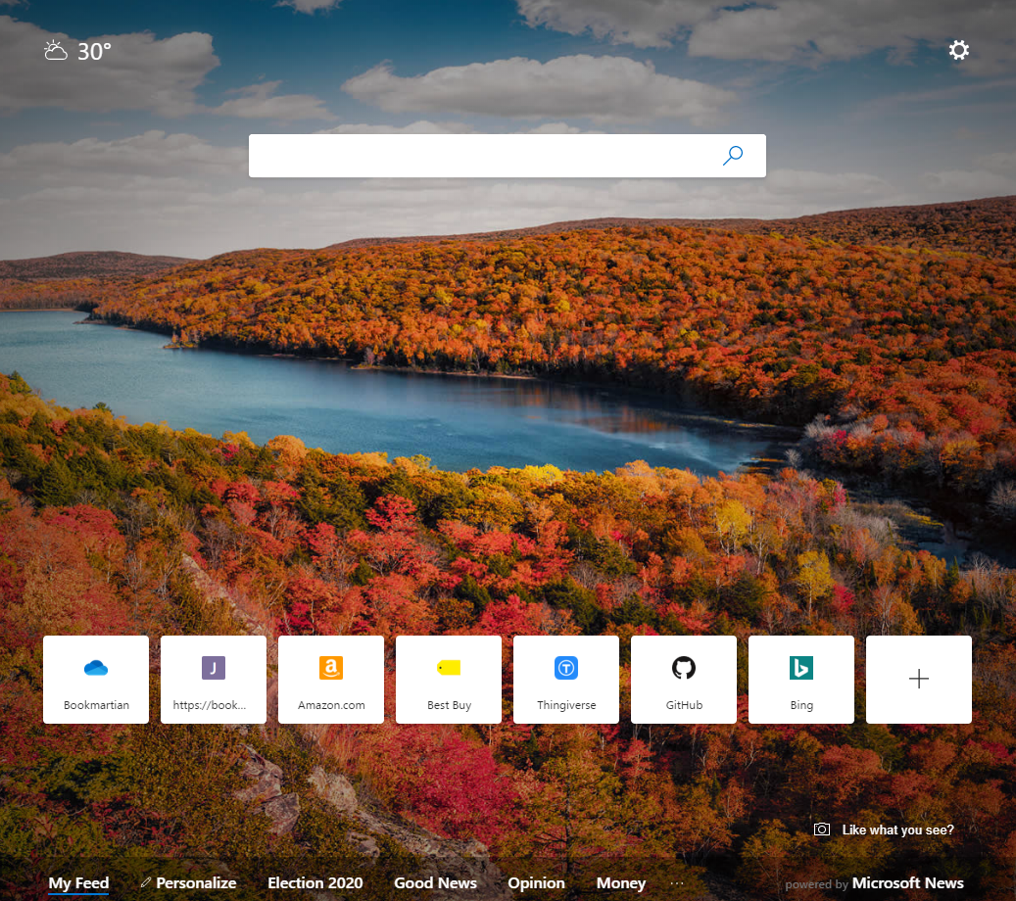
Taking inspiration from the “new tab” design in Edge (chromium) →

Slide 2
Always present search bar defaults to your favorite search engine but “toggles” to a bookmark search?
Configurable background image or pulled from a curated collection / feed (like Instagram or something)
Promoted tiles like we have today (populated with a tag query)
 | Home | Work | D&D | Tags | [Bookmartian]

Slide 3
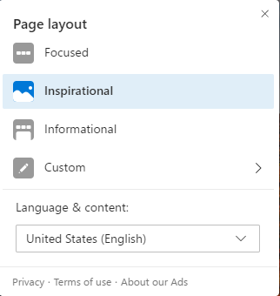
Settings icon drops down list of links to configuration options, some of which probably just open different pages.
IDEA: what if all of your settings are defined elsewhere in a JSON document… maybe stored in a gist? If that gist is publicly accessible, you could easily tell bookmartian where it is from any computer and get your full “dashboard” setup without having to mess with long query strings. For example: jm-marks.foo.com?config=7ykiu could refer to a bit.ly or tiny.url code.
Bottom of the screen hints at more content (which is available ‘beneath the fold’ – scroll down)
 | Home | Work | D&D | Tags | [Bookmartian]

Slide 4
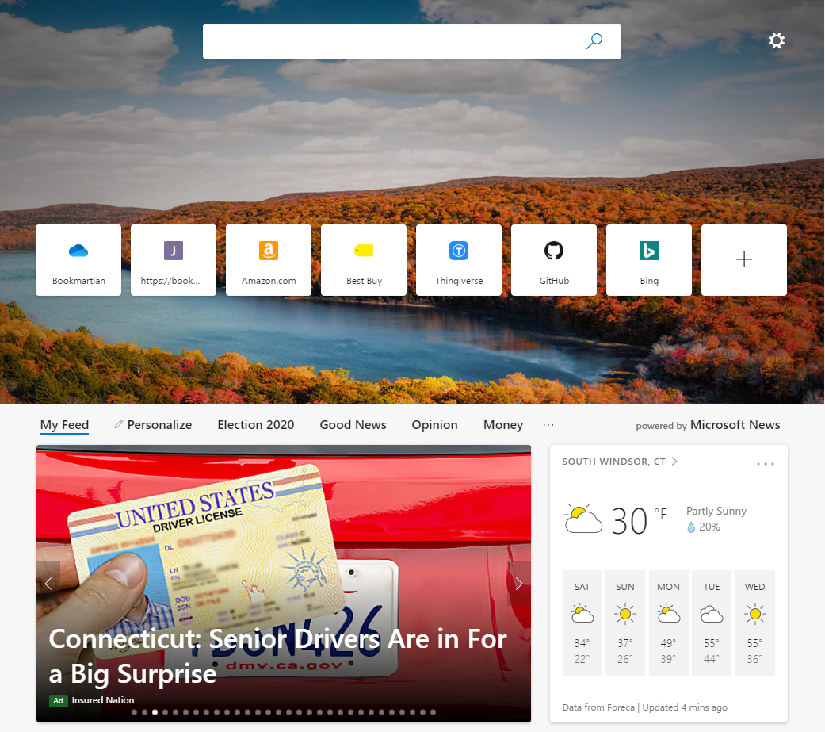
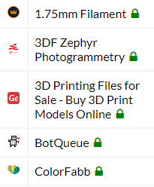
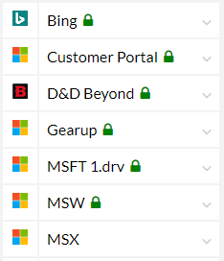
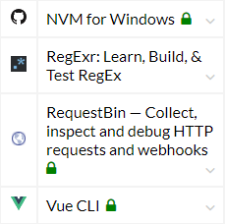
As you scroll down, the search box moves to the top of the screen and the tiles move up.
Beneath the fold, a default tab opens with other pinned content. Mostly search results, like we have now, but could also include other content types. Clicking on one of the other tabs (e.g. Work) just swaps the entire content page on the bottom with another pre-configured dashboard.
 | Home | Work | D&D | Tags | [Bookmartian]
to-read
to-read
sdf
recently-visited
visited-since:1w+as:recently-visited
sdf
code-helpers
code+tools+as:code-helpers

Slide 5
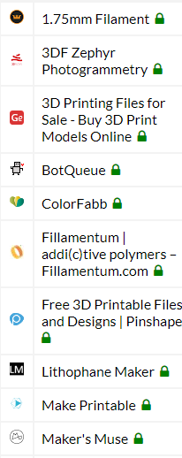

Eventually the tiles disappear and all that is left is the search bar and the dashboard pages below.
 | Home | Work | D&D | Tags | [Bookmartian]
to-read
to-read
sdf
recently-visited
visited-since:1w+as:recently-visited
sdf
code-helpers
code+tools+as:code-helpers
other-stuff
code+tools+as:code-helpers

Slide 6
I’m not entirely sure how this “Tags” dashboard lays out… but the idea is to replace the long list on the left of the current ui. As you click on tags, I’m thinking that it just builds a progressive search query for you… needs more thought. One idea though is that as you click a tag, the tag cloud itself downsizes to only those tags that co-exist on a bookmark. Make sense?
 | Home | Work | D&D | Tags | [Bookmartian]
to-read 3d-models 3d-printing aad active-msft advice and api apps architecture arm art article artists at-the-table audio aws azure billing bits blog bookmarklet bookmarks bookmartian books borderlands boston brewery build calculator cards certification characters circuits cli clothes cloud cnc code college color comics community compete component conference config console convert costumes csharp css customization demo design destiny dev devops dice dmscreen dnd docker docs ea ebooks education emoji encounters energy events faq feed filament finance flow fonts food framework frequent fun fy18 fy19 fy20 fy20-airlift gadgets games geek generator gifts git github gov governance hacks halloween hdd home homebrew how-to hue hyper-v iaas icons identity image imageprocessing images incentive inspiration internal iot javascript journal kitchen lab labs lehigh linkedin linux lists logicapps magic-items magicitems manual map maps materials medical microsoft money monitoring monsters mooncake mp3 msa msft msit msx mtg music network networking news nodejs npc octoprint office office365 onedrive onenote online opensource organization oss paper papercraft partners patreon patterns pc pdf photogramy photoshop physics plans playbook playlists podcast policy portable portal portraits posters powerbi powerpoint pptx premier presentations pricing programs promote promote-dnd promote-msft proposal puzzles python qrcode randomtables readiness reading reference regex reliability repo reports research rest rfp rpg sales sas school script search security serverless servicebus services sharepoint sharing sho shop shopping shortcuts slack social software southwindsor speakers spells spotify sql srd starwars stickers stl streaming support svg system t-shirts tabletop tailor tea teaching templates terminal test text textures to-read-msft tools training travel tsp utc utilities ux vba vector video visio vs vscode vsts vue wallpaper web webcam whitepaper whitepapers wiki windows wordpress wwic xbox youtube
Ambitious, you say?
Yes.
Yes, it is.

Slide 7

Alternate default view (compromise)
 | Home | Work | D&D | Tags | [Bookmartian]
to-read
to-read
sdf
recently-visited
visited-since:1w+as:recently-visited
sdf
code-helpers
code+tools+as:code-helpers
other-stuff
code+tools+as:code-helpers

Slide 8
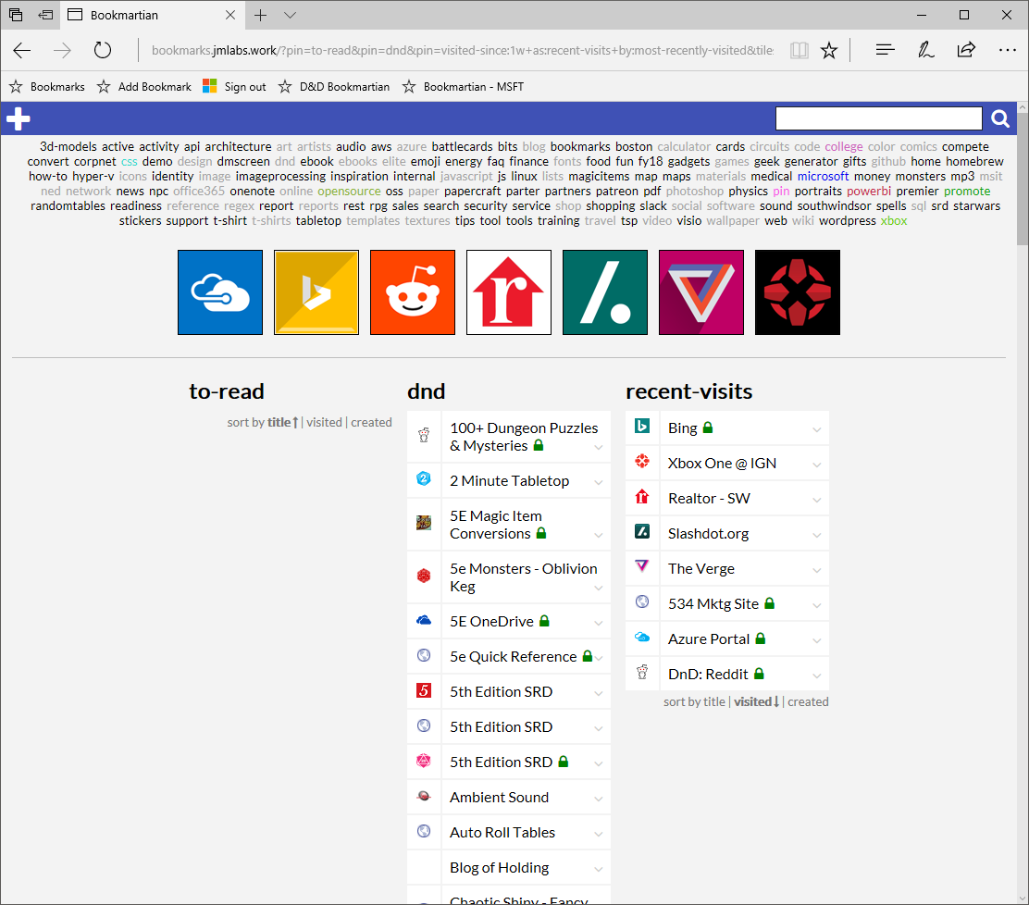

Slide 9



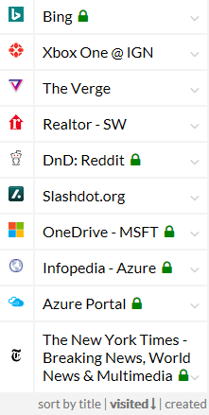
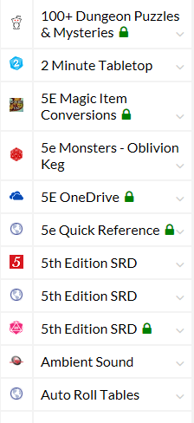
my links
3dmodels
active
activity
api
architecture
art
artists
audio
aws
azure
battlecards
bits
blog
bookmarks
boston
calculator
cards
circuits
code
college
color
comics
compete
convert
corpnet
css
demo
design
dmscreen
dnd
ebook
ebooks
elite
emoji
energy
faq
finance
fonts
my links
dnd
recent-visits
dnd …
recent-visits …
another-pin …

Slide 10
my links
Bookmartian
3dmodels
active
activity
api
architecture
art
artists
audio
aws
azure
battlecards
bits
blog
bookmarks
boston
calculator
cards
circuits
code
college
color
comics
compete
convert
corpnet
css
demo
design
dmscreen
dnd
ebook
ebooks
elite
emoji
energy
faq
finance
fonts
Title
my links
URL
dnd
recent-visits
another-pin
Tags
Notes
Image URL
dnd …
recent-visits …
another-pin …
save
cancel

Slide 11
my links
Bookmartian
3dmodels
active
activity
api
architecture
art
artists
audio
aws
azure
battlecards
bits
blog
bookmarks
boston
calculator
cards
circuits
code
college
color
comics
compete
convert
corpnet
css
demo
design
dmscreen
dnd
ebook
ebooks
elite
emoji
energy
faq
finance
fonts
Title
my links
URL
dnd
recent-visits
another-pin
Tags
Notes
Image URL
save
cancel
dnd …
recent-visits …
another-pin …

Slide 12
my links
3dmodels
active
activity
api
architecture
art
artists
audio
aws
azure
battlecards
bits
blog
bookmarks
boston
calculator
cards
circuits
code
college
color
comics
compete
convert
corpnet
css
demo
design
dmscreen
dnd
ebook
ebooks
elite
emoji
energy
faq
finance
fonts
my links
dnd
recent-visits
another-pin
Title
URL
Tags
Notes
Image URL
dnd …
recent-visits …
save
cancel
another-pin …

Slide 13
top promoted
3dmodels
active
activity
api
architecture
art
artists
audio
aws
azure
battlecards
bits
blog
bookmarks
boston
calculator
cards
circuits
code
college
color
comics
compete
convert
corpnet
css
demo
design
dmscreen
dnd
ebook
ebooks
elite
emoji
energy
faq
finance
fonts
news and info
dnd
recent-visits
another-pin

Slide 14


Slide 15





Querystring parameters drive the page display so that you can easily have a ‘home’ and ‘work’ view
http://bookmarkhomepage.jmutchek.com?promote=microsoft,d&d,materials
All tags as links to quickly filter/search
animation art artist azure blog brush cli color comic convert cool css d&d dashboard data décor diy dns ebook electronics filter font forum game git hometheater http icon image iot itpro javascript jewelry leather list logo malpen map materials microsoft o365 oss outdoor paper photo photoshop php physics powerbi print programming reference regex rest rpg scripting security service shop simulator software sql t-shirt textures tinker tools travel tutorial utility vector video wallpaper web wiki
Search for more complex tag queries and fulltext
Promoted links: either by frequency or a sort order / priority
microsoft
d&d
materials
Not sure of the sort order here… or if this is a complete list or just “top n”
Promoted tags: specified on query string?
 | Fiscal year reporting FY17 updated once per month
 | Roadmap decks
 | Human Resources
 | US Travel
 | Monthly Training
 | Taxidermic Owlbear
 | Giant in the Playground (5E)
 | One Use Magic Items (5E)
 | Kobold Fight Club
 | 5th Edition SRD
 | Jelinek Cork Group
 | K&J Magnetics
 | Sugru Fix that thing clay
 | TAP Plastics
 | Playing Surface Fabric
 | More good stuff
 | Shapeways 3D Printing
 | Hobby chemicals
 | Unusual paints
Dynamic tags: recent, frequent, etc.
recently added
freqently used
 | Taxidermic Owlbear
 | Sugru Fix that thing clay
 | Human Resources
 | US Travel
 | Monthly Training
 | Kobold Fight Club
 | Roadmap decks
 | US Travel
 | Monthly Training
 | Monthly Training

Slide 16


http://bookmarkhomepage.jmutchek.com?search=d&d
After a search
d&d
animation art artist azure blog brush cli color comic convert cool css d&d dashboard data décor diy dns ebook electronics filter font forum game git hometheater http icon image iot itpro javascript jewelry leather list logo malpen map materials microsoft o365 oss outdoor paper photo photoshop php physics powerbi print programming reference regex rest rpg scripting security service shop simulator software sql t-shirt textures tinker tools travel tutorial utility vector video wallpaper web wiki
d&d
favicons?
 | Taxidermic Owlbear
 | Giant in the Playground (5E)
 | One Use Magic Items (5E)
 | Kobold Fight Club
 | 5th Edition SRD
 | Sly Flourish
 | Wizard of the Coast
 | Neverwinter Nights
 | The Angry DM
Edit controls, etc. appear on hover?

Slide 17
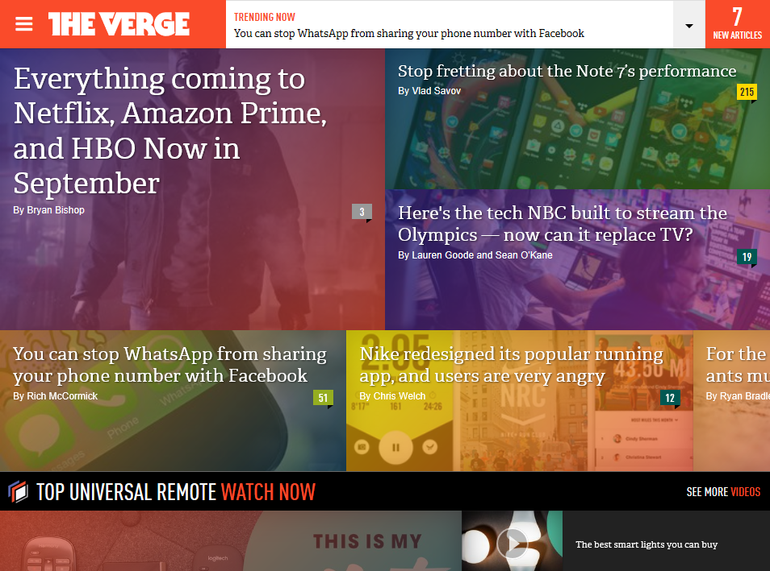
http://theverge.com
Bookmarklet while browsing
BOOKMARKLET
Add a bookmark…
Name:
The Verge
Tags:
news tech gadgets
✓
URL:
http://theverge.com
Advanced
Advanced options might expose favicon, icon, disable fulltext, etc

Slide 18
